Slide 1
Automation Framework
May 20, 2013
sarathbabu.bejavada@ngahr.com
Notes:
www.northgatearinso.com
Copyright NorthgateArinso. All rights reserved.
1

Slide 2
Auto run Issue Finding
2

Slide 3
Contents
Typical ways when issue can be encountered
Types of Issues
Analysis of Issues

Slide 4
When Issue can be encountered
Flow Chart Interpreting types Issues can encounter in Auto Run
Auto Run
PASS
No Issue
FAIL
Manual Re verification
FAIL
Application Issue
PASS
1

Slide 5
1
Auto Issue
Environment
Test Script
Framework

Slide 6
Types of Auto Run Issues
From previous chart we can conclude following
In Auto Run when script is passed no issue.
When script failed next step needs to do is manual re verification.
If manual verification fails that is an application issue.
In case test instance working fine after verifying manually then issue will be with
Automation Test script Designed
Framework we are using to execute scripts
Environment

Slide 7
Analyzing issue encountered in test script
In analyzing the issue first priority has to be given to script that is executed and following steps will be helpful
Use same data mentioned in script
Check step by step manually based on script and try to simulate exact actions that automation tool is performing on browser.
Check if there are any UI changes and updated rules accordingly
If still not able to find out where the issue is write simple sample script that will simulate test scripts action in python or rf script and execute them with out using framework.
Main Idea here is if issue is in framework then sample script will work properly.

Slide 8
Analyzing issue encountered with framework
Following example will describe how to analyze issue if issue is in framework.
Example will refers to euHReka-work flow and issue #101 reported in GitHub
Issue Description: My employee selection is not loading properly after navigated to time view with HRA login in Auto run. Same employee selection is loading properly when manual check is performed.
From the above points it can be concluded that the issue is either with Framework or environment. This conclusion has to be done only after verifying Automation test script .Here assuming a pre condition that test script do not contain any issues.

Slide 9
Next step needs to do is execute simple script either in python or rf script that are mentioned in automation test script up to the point issue encountered in the same environment.
Since the issue is replicated after navigating to time views with HRA login, same steps are executed with simple script independent of framework.

Slide 10
Executing simple script 1 code independent of framework
from selenium import webdriver
from selenium.webdriver.support.ui import WebDriverWait
driver = webdriver.Firefox()
driver.get("https://eqc.euhreka.com/sap/public/bc/ur/eWS/standard/newlogInPage.html?sap-client=510")
inputElement1 = driver.find_element_by_name("name")
inputElement1.send_keys("GL_AU_MG001")
inputElement2 = driver.find_element_by_name("password")
inputElement2.send_keys("ews12345")
driver.find_element_by_xpath("//*[@id='loginButton']").click()
driver.implicitly_wait(40)
driver.find_element_by_xpath("//*[@id='subMenu_WA_PT']").click()

Slide 11
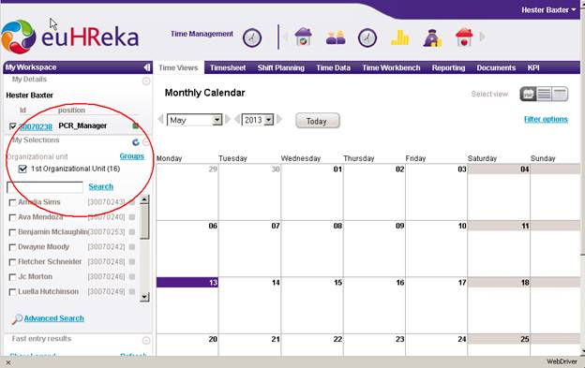
Screen shot got after executing sample script 1

Slide 12
Script 2 reloading the page for tab navigation simulates framework action
from selenium import webdriver
from selenium.webdriver.support.ui import WebDriverWait
import re
driver = webdriver.Firefox()
driver.get("https://eqc.euhreka.com/sap/public/bc/ur/eWS/standard/newlogInPage.html?sap-client=510")
inputElement1 = driver.find_element_by_name("name")
inputElement1.send_keys("GL_AU_MG001")
inputElement2 = driver.find_element_by_name("password")
inputElement2.send_keys("ews12345")
driver.find_element_by_xpath("//*[@id='loginButton']").click()
driver.implicitly_wait(40)
driver.find_element_by_xpath("//*[@id='subMenu_FW_HOM']").click()

Slide 13
appid="VIEW_PT"
url, reps = re.subn(r'(https?://.*#app=).*', r'\1%s' % (appid), url)
driver.get(url)
driver.refresh()
driver.implicitly_wait(40)

Slide 14
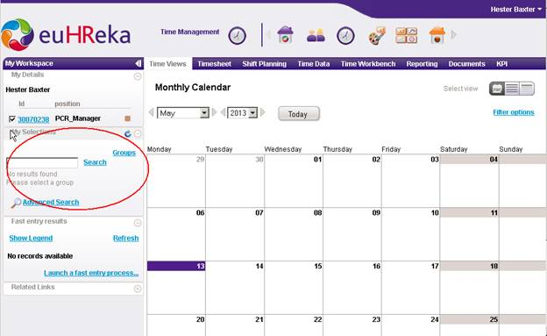
Screen shot after re loading page for tab navigation by executing sample script 2

Slide 15
Key points from the two sample scripts
In framework we are navigating to any tab by reloading the page after appending appid to current url. This is implemented for faster navigation. Script 2 simulates same actions and employee selection is not loaded in this case
After executing sample script 1 observed that My employee selection is loading properly.
So working environment is fine and issue is present in framework.
In sample script 1 we are navigating to tab by using clicks on sub module and after that on tab. If in the framework if we implement exact clicks instead of page reloading then employee selection will get loaded properly

Slide 16
Framework changes to be done to solve the issue
In framework tab navigation using clicks is already present.
To work with 510 ui needs to do following 2 changes.
In 510 ui, modules are not present .So by adding one simple if condition in navigate to tab keyword for verifying modules visibility will work for both eqc 800 and eqc 510.So modified code will work in such a way that proceeds with modules if they are visible and proceeds with sub modules if modules are not visible.
In 510 ui tabs class are inactivetab and activetab. So needs to add one dummy class inactivetab and activetab for identifying tabs.

Slide 17
Analyzing issue encountered due to environment
Even if sample script is not working then issue will present in environment.
Environment issue can be due following.
Browser
Selenium Version
Python Version
Robot framework
Following is the environment currently using and need to check is there any deviation in case of auto run failures.
Firefox browser version should not be more than 17.
Selenium version 2.9
Python version 2.7.2
Robot Framework 2.7.1

Slide 18
#100 issue from GitHub, euHRwork flow can be taken as an example for environment issue.
Log off is not working with new base line 510 ui and with current environment.
Even if sample script is executed independent of framework log off wont work since auto scroll option is not working in selenium 2.9 version. Selenium fails to identify log off button.
If browser is maximized at the time of log off then web driver will recognize the log off and this way issue can be fixed easily.

Slide 19
References
Selenium Library useful for RF scripting
http://robotframework-seleniumlibrary.googlecode.com/hg/doc/SeleniumLibrary.html?r=2.9.1
Robot framework RF scripting guide
https://twiki.cern.ch/twiki/bin/view/EMI/RobotFrameworkAdvancedGuide
Selenium web driver library using python
http://docs.seleniumhq.org/docs/03_webdriver.jsp#webdriver-and-the-selenium-server

Slide 20
Thank Q
20

